Slide 1
Conductors at RF and Transmission Lines
Week 1

Slide 2
At DC
Resistance = Length / (Conductivity * Cross Sectional Area)
Resistance = Length * Resistivity / CSA
At DC, whole conductor is used to carry the current

Slide 3
At AC
Resistance increases with frequency because of skin effect (inductance)
XL = jwL where w = 2pi f ao XL = j 2 pi fL
RF current flow migrate to the outer edge of the conductor to flow along path with least resistance

Slide 4
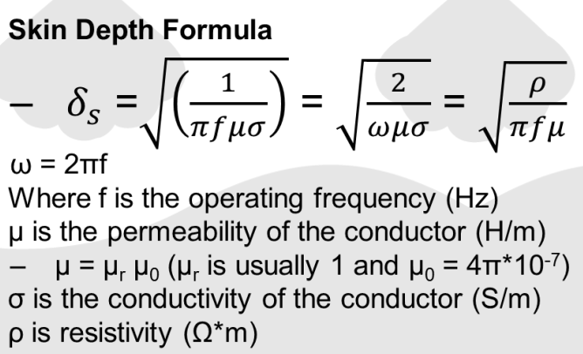
Skin Depth Formula

Slide 5
Common Transmission Lines
TV and RF cables
Microstrip
Twisted Pair

Slide 6
Size of Transmission Lines
Length of cable >0.1 lambda (1/10 of wavelength of transmitted signal)
If not:
Reflection
Radiation

Slide 7
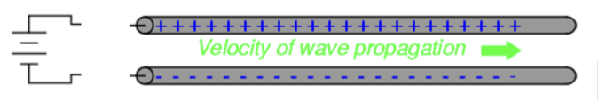
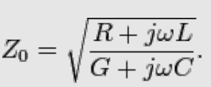
Characteristic Impedance
A transmission line of infinite length, what happens when a battery is connected?

Slide 8
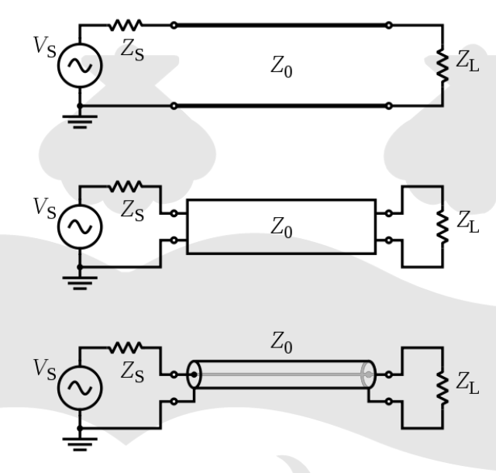
Transmission Line Models
Zs = input impedance
Zo = characteristic impedance
ZL = load impedance

Slide 9
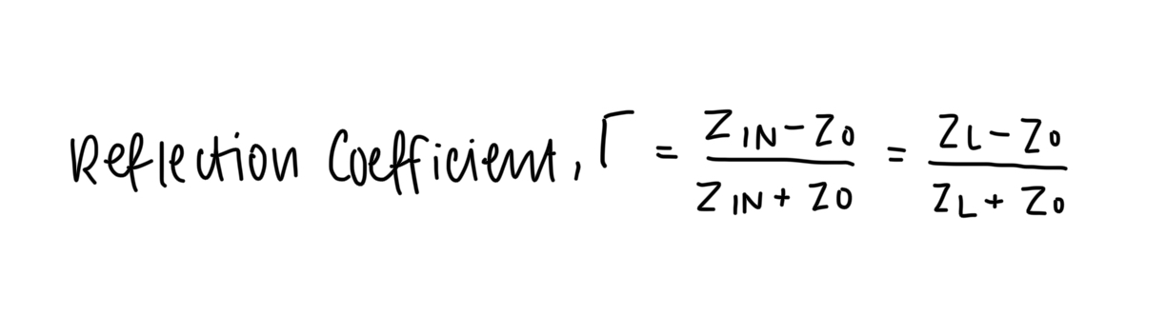

Slide 10
dBs and Link Budgets
Week 2

Slide 11
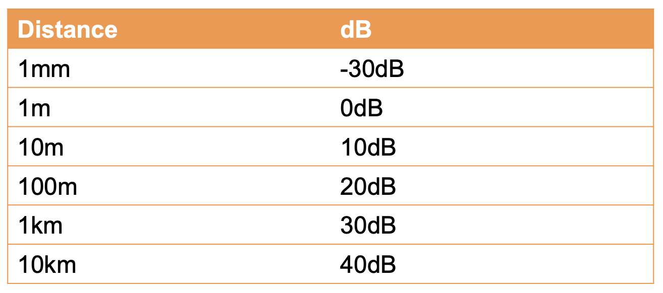
Why dB?
dBs compress the dynamic range and put everything on the same scale
For example:

Slide 12
Transmit & Receive Power
Communication Systems | Received Power | Transmit Power
GSM | -51dBm | Varies @ 900 & 1800MHz
GPS | -155 dBW (-125dBm) | 25.6W @ 1573MHz
WiFi | -75 dBm or better | 100mW (1W) @ 2.4GHz
Voyager Space Ships | -231dBm | 18W @ 8GHz

Slide 13
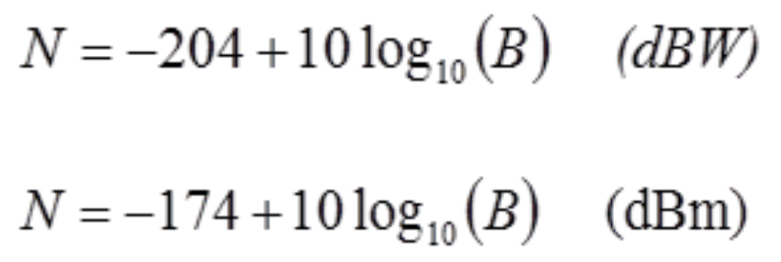
Thermal Noise

Slide 14
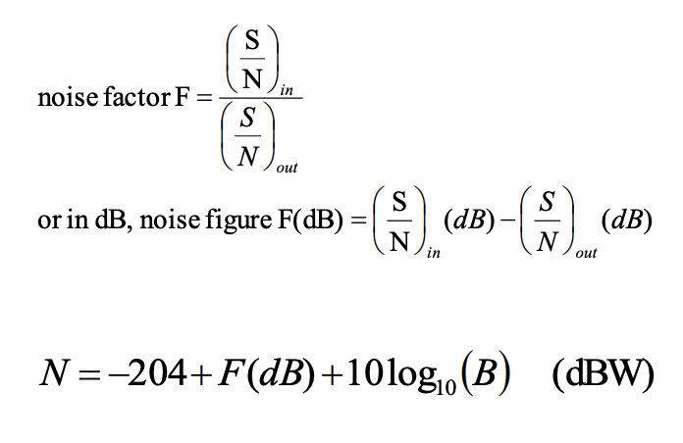
Noise Factor & Figure

Slide 15
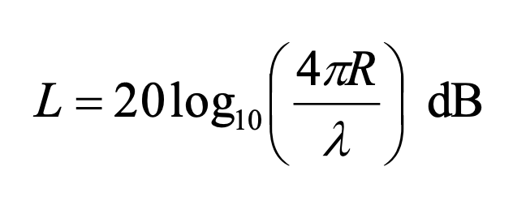
Path Loss
R is distance from transmitter
Lambda is c/f

Slide 16
L Matching and Smith Charts
Week 3

Slide 17
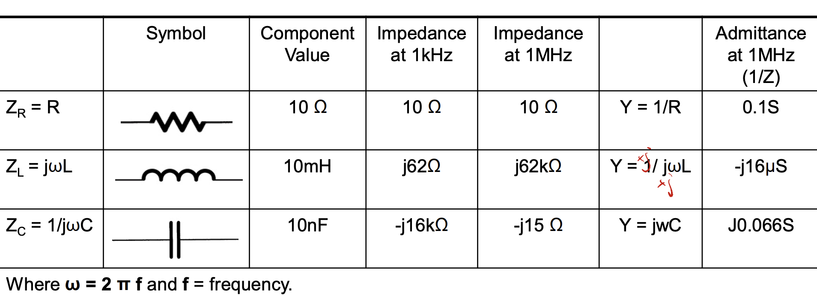

Slide 18


Inductance and Capacitance
+j (up the smith chart)
-j (down the shirt)
 | Series | Shunt (Parallel)
 | -j | + j
 | + j | -j

Slide 19
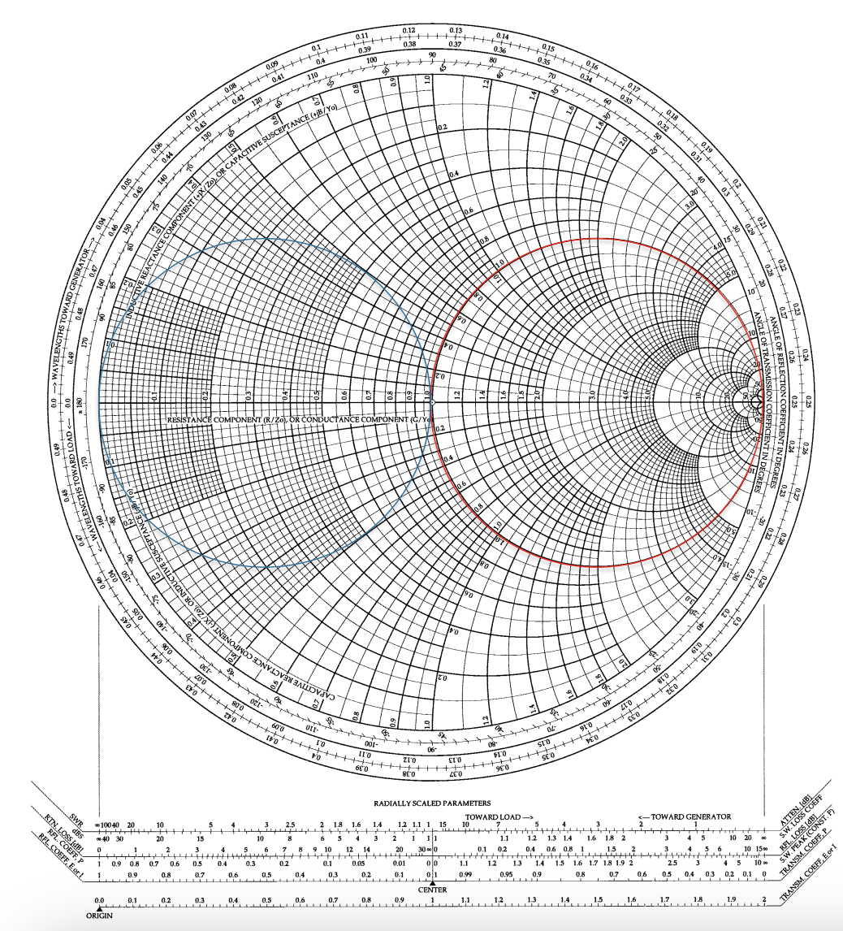

Slide 20
Week

Slide 21
Week

Slide 22
Week

Slide 23
Week

